Slide 1

Modeling Academic Success with an Exponential Twist
Internship Question 1 – Mohit Bhimrajka

Slide 2
What am I Doing?
As I was brainstorming, I thought, let's keep it real. I'm a student, and you're the teacher. So, why not dive into something we all deal with—attention span in lectures? I want to build a model around it. What do you think? Intriguing, right?
Now, to ensure the utmost personalization and relevance in this presentation and model, I will incorporate data and scenarios specific to our esteemed professor, Dr. Sridhar Pappu, and his 'Foundation of Statistics' class during Semester 1.

Slide 3
Key Components for Analysis
To construct a comprehensive understanding, we'll explore factors such as:
initial attention levels
maximum achievable attention
the rate of improvement

Slide 4
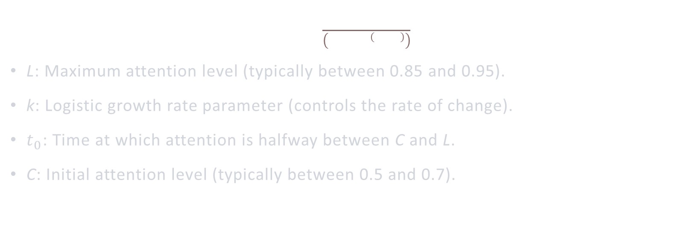
The REAL DEAL
$P\left(t\right)=L\frac{L}{\left(1+ⅇ^{−k\left(t−t_{0}\right)}\right)}$ + C
L: Maximum attention level (typically between 0.85 and 0.95).
k: Logistic growth rate parameter (controls the rate of change).
$t_{0}$​: Time at which attention is halfway between C and L.
C: Initial attention level (typically between 0.5 and 0.7).

Slide 5
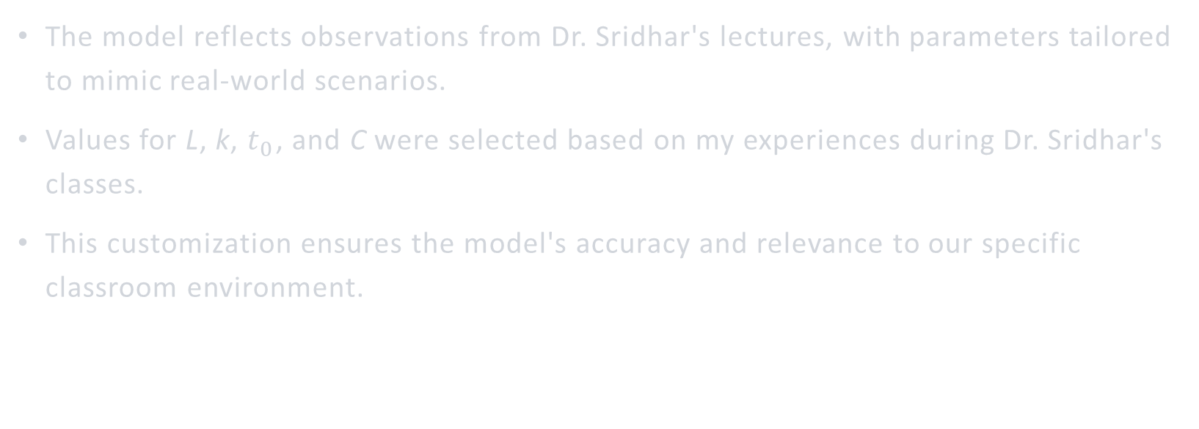
Personalized Parameters
The model reflects observations from Dr. Sridhar's lectures, with parameters tailored to mimic real-world scenarios.
Values for L, k, $t_{0}$​​, and C were selected based on my experiences during Dr. Sridhar's classes.
This customization ensures the model's accuracy and relevance to our specific classroom environment.

Slide 6
Why the Sigmoid Function Works
Honestly, After experimenting with various functions and testing multiple alternatives, I found that the sigmoid function closely aligns with the desired outcomes I sought to achieve. Its effectiveness lies in its ability to accurately represent the observed patterns in student attention span during lectures. Essentially, the model that yields the most accurate results is the one that effectively captures the dynamics of our classroom environment, making the sigmoid function the right choice for our analysis.

Slide 7
But why this function?
The exponential function captures the natural decay of student attention over time in lectures.
Parameters such as initial attention level, maximum achievable attention, and decay rate allow customization to specific teaching dynamics.
Insights from the model aid in optimizing teaching strategies for maintaining student engagement and maximizing learning outcomes.

